Slide 1
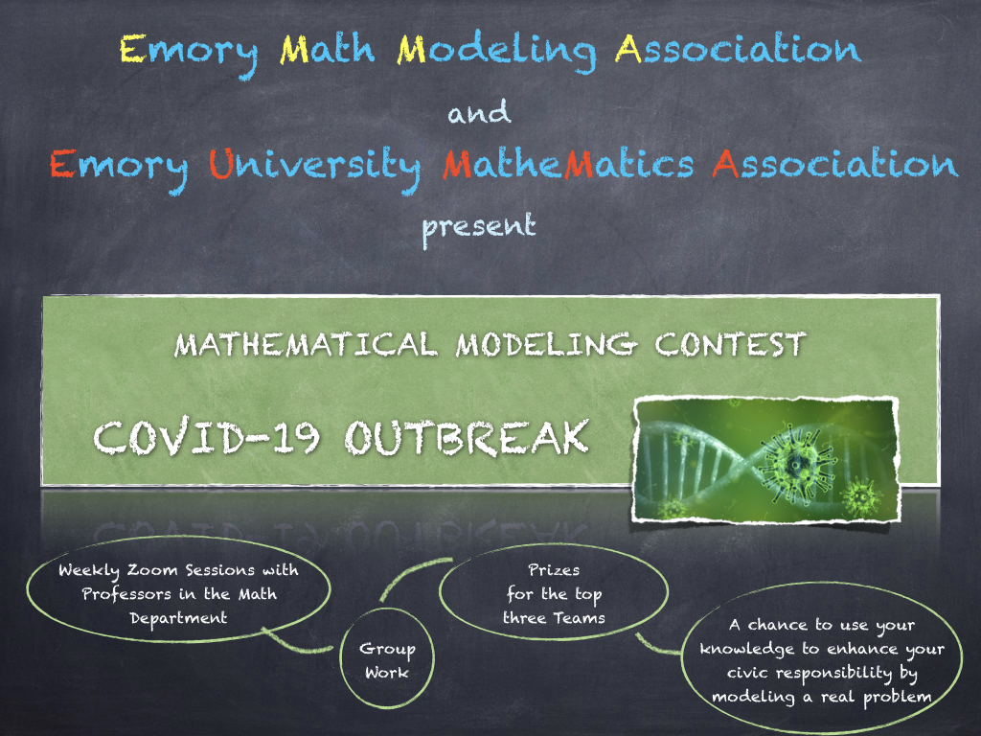
ALESSANDRO VENEZIANI avenez2@emory.edu

Slide 2
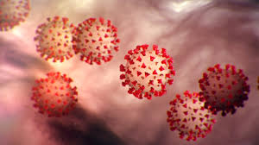
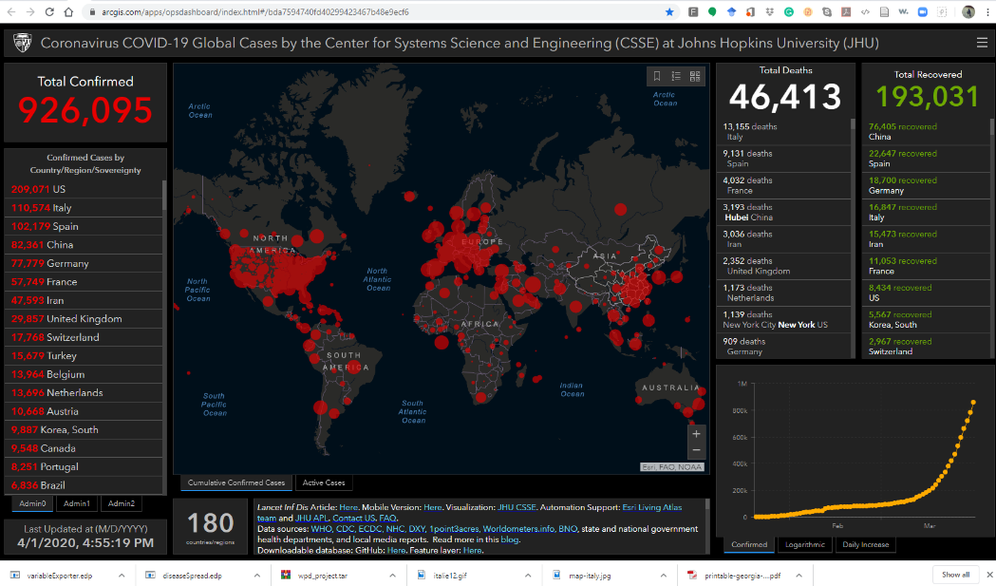
Outline
Introduction
The CANVAS Web Page (A. Veneziani)
The basic model: Susceptible-Infected-Recovered (L. Shu)
From ODEs to PDEs: the Second Derivative, the Laplace Operator, Diffusion (M. Taskovic)
Software Support (A. Veneziani)
The project: how and when
Possible research lines (suggestions)
Q&A
https://www.cdc.gov/coronavirus/2019-ncov/cases-updates/cases-in-us.html
https://ourworldindata.org/coronavirus
https://systems.jhu.edu/research/public-health/ncov/
https://sinews.siam.org/Details-Page/covid19

Slide 3
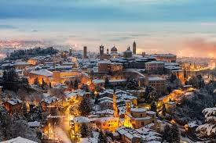
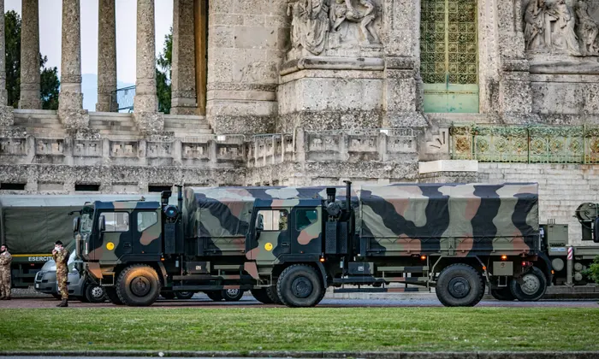
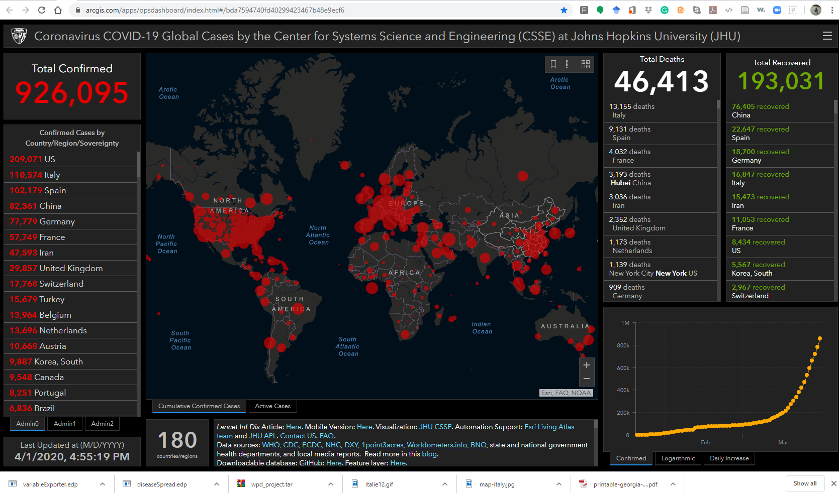
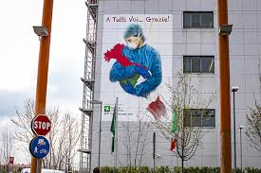
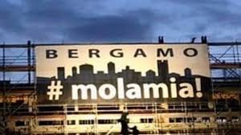
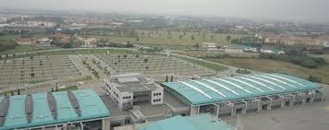
Motivations
Bergamo, est. 49 BC
Mathematical Models to
Understand
Predict
Optimize
Mathematics is the Language and the Reasoning:
It is the common denominator of Science, it is our common ground for a truly collaborative effort
Hospitals with 300 Volunteers
Built in 6 days
#EMORYdontGiveUp!

Slide 4
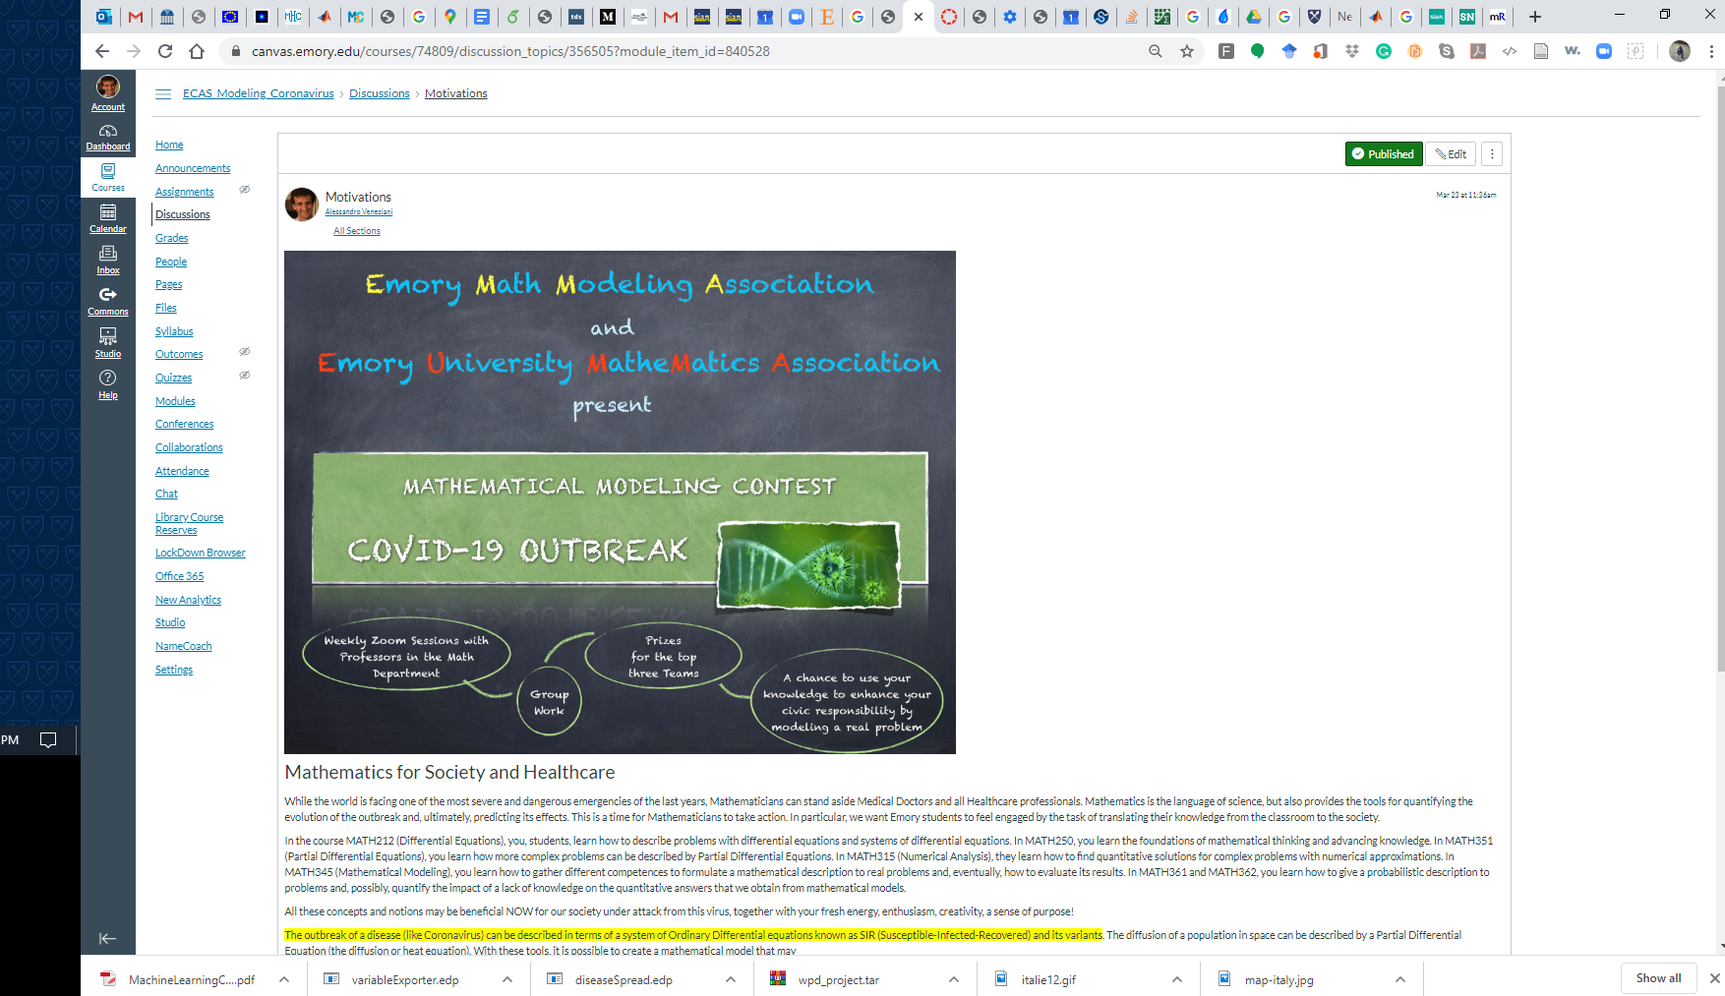
The CANVAS Page

Slide 5
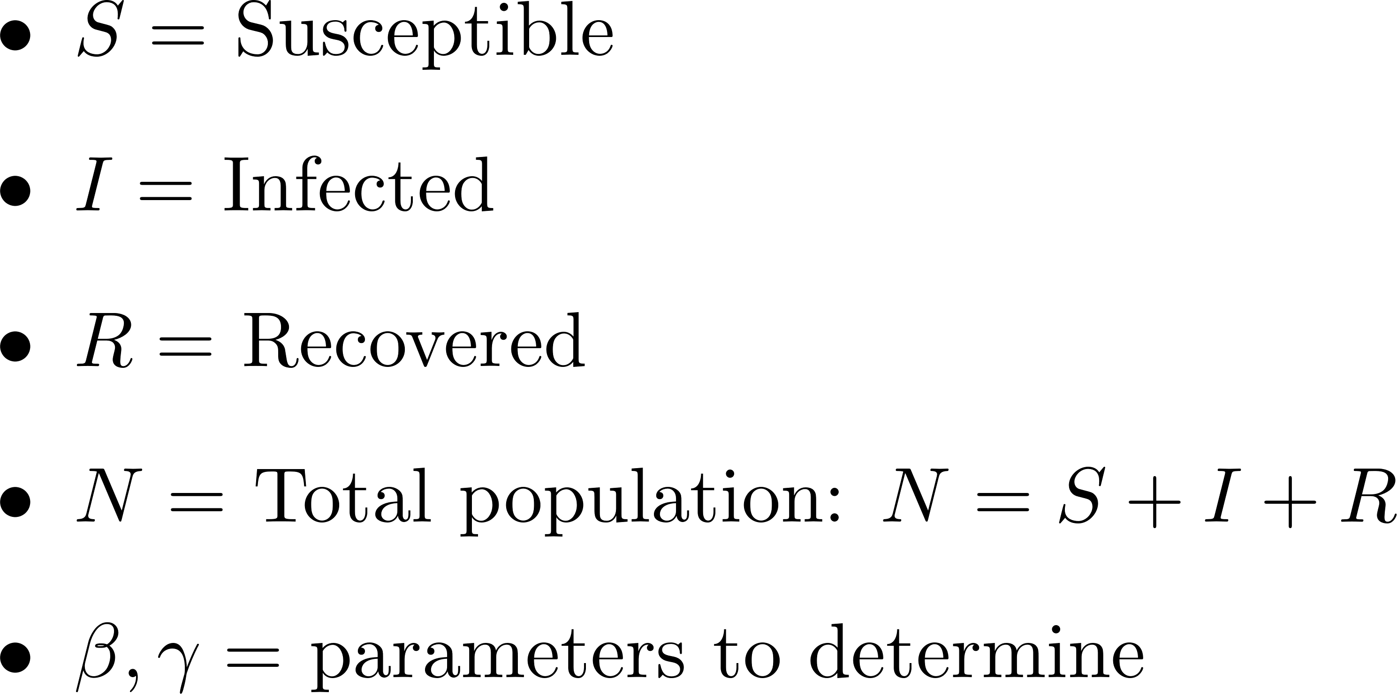
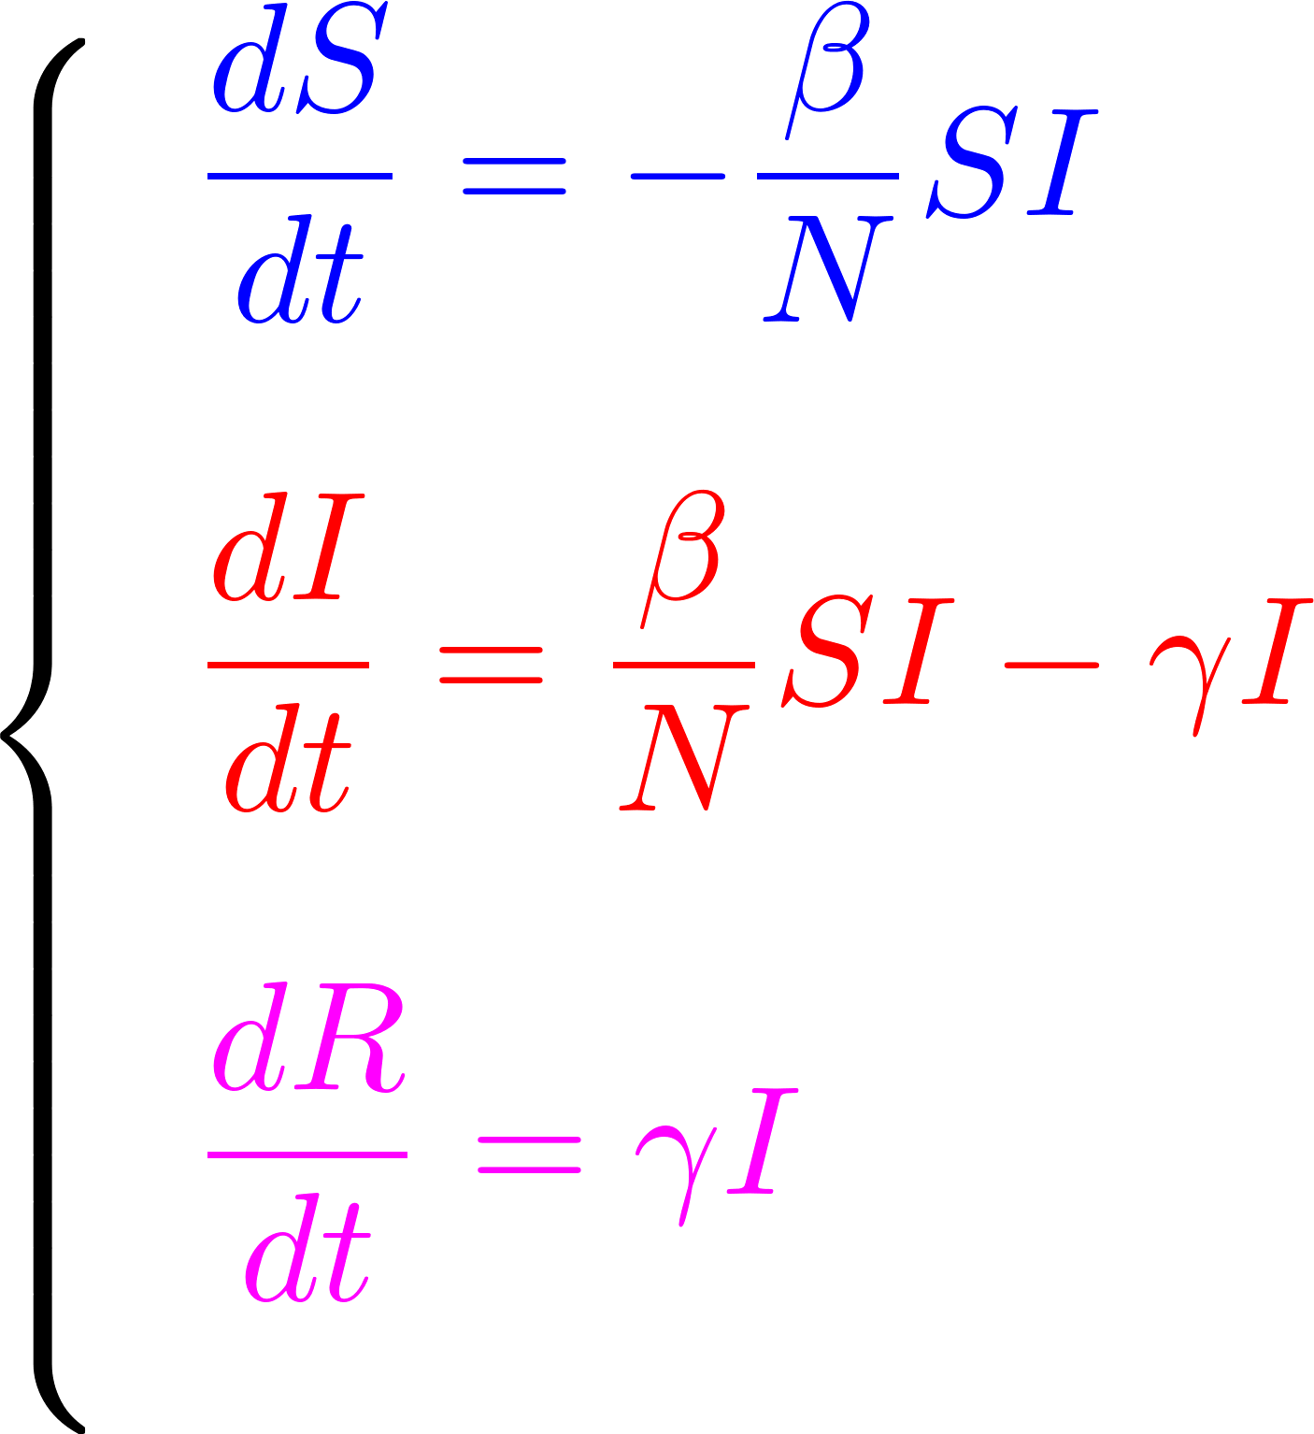
The SIR Model
A nonlinear Ordinary Differential Equation System
Longmei

Slide 6
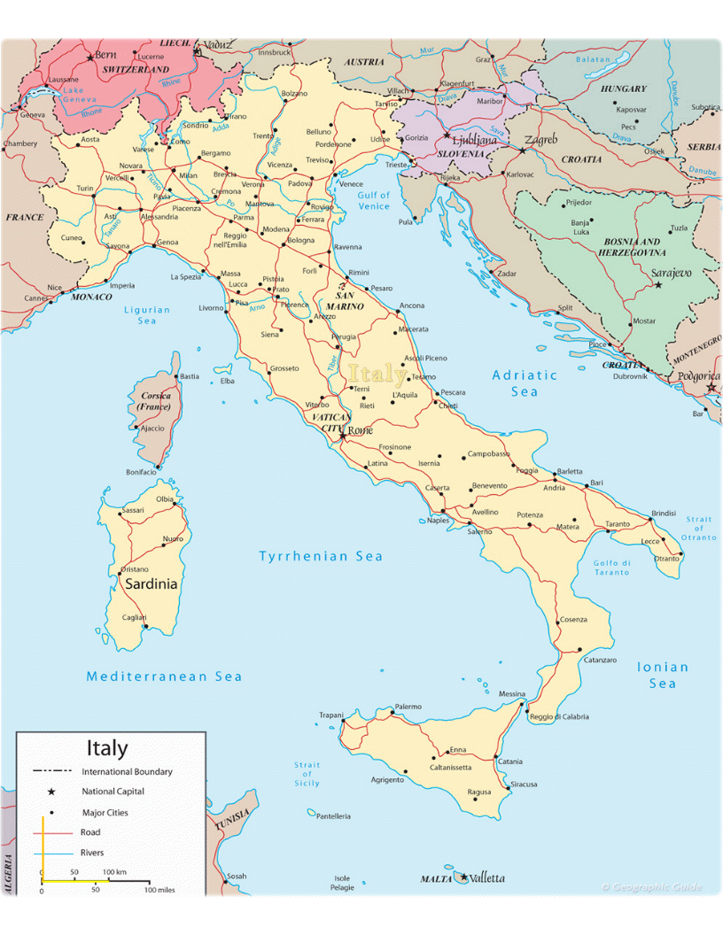
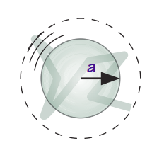
The Laplace Operator and the Diffusion Process
Infected
DYNAMICS COMPONENTS FOR SPACE DEPENDENCE:
Long range motion (e.g. on highways, railways, etc.)
Local motion (probabilistic description)
SIR
Infected
1
2
5
3
How can we describe the motion?
4
Compartment Modeling
Space Dependent Modeling
Maja

Slide 7
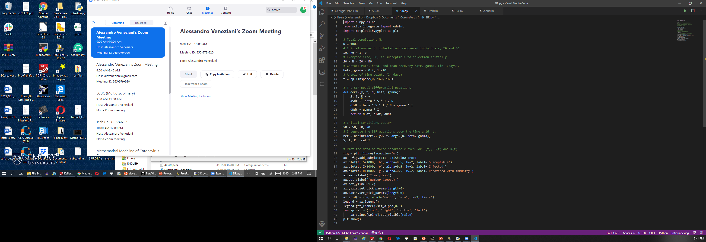
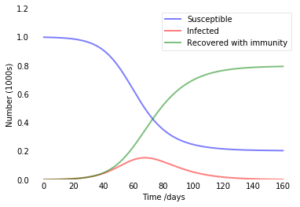
Software
Sir.py
Sir.m
*.edp file (TBA)
FreeFem++ recommended with MATH352

Slide 8

Possible Research Lines
Susceptible/Infected populations split by
Age (Y/E)
Gender (F/M)
Geography (Compartments)
Add Exposed to the SIR model
Machine Learning Approaches
Modeling the effects of Travel Restrictions
Modeling the effect of Social Distance
Combining Data and Models to make prediction (Data Assimilation)
Combining Data and Models to estimate the coefficients
Model the space dependence with PDEs
#EMORYdontGiveUp!

Slide 9
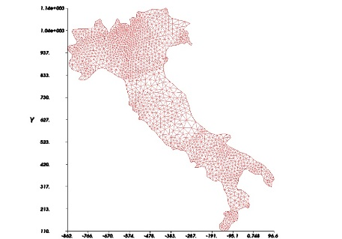
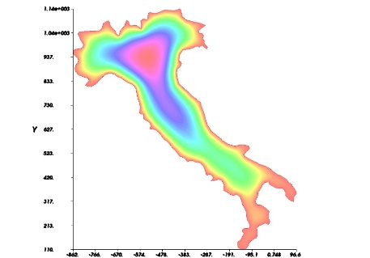
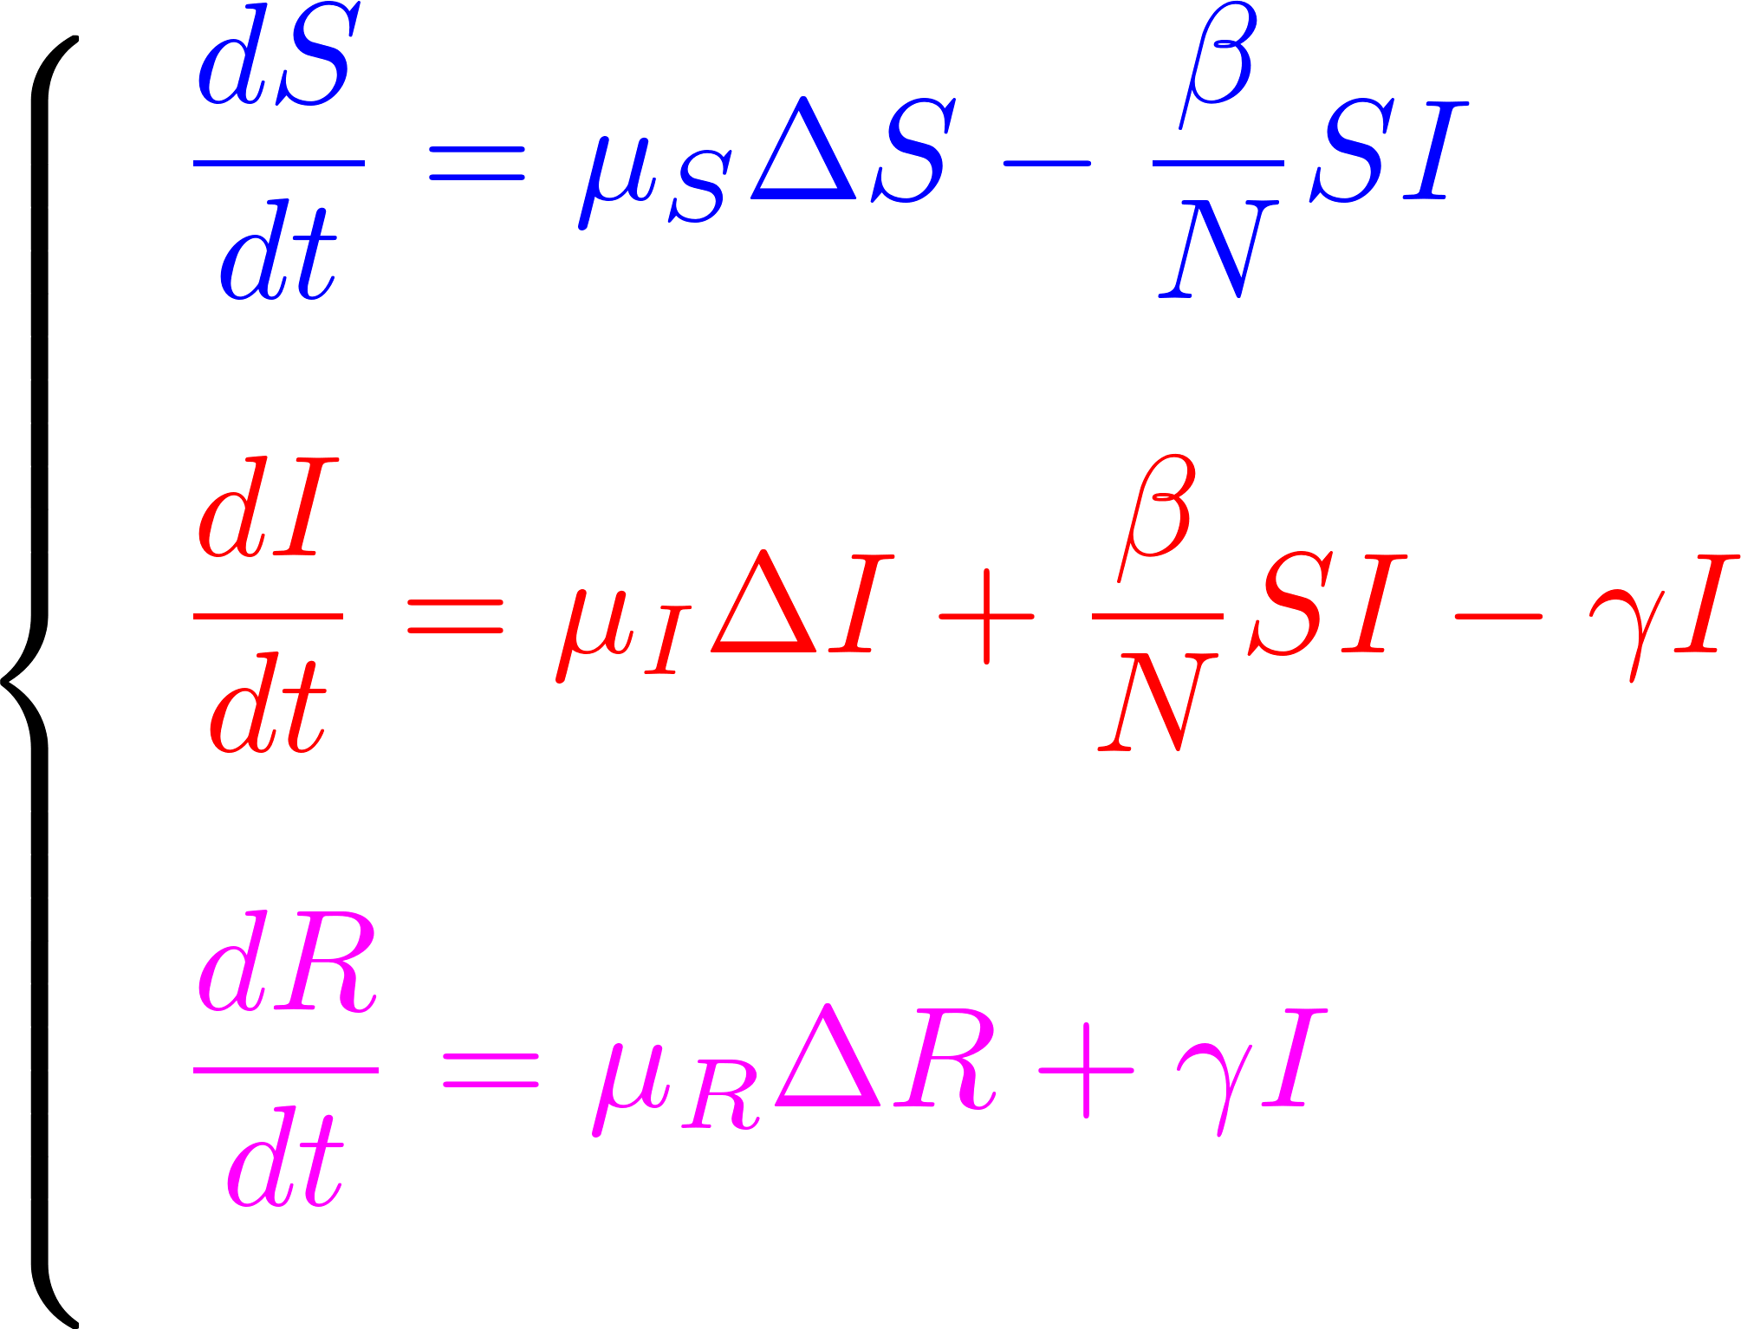
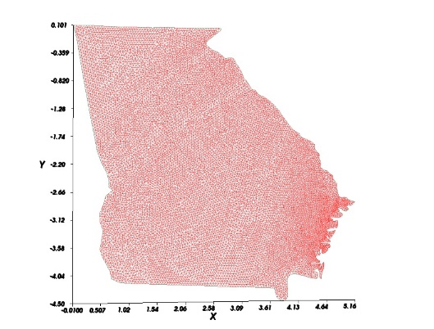
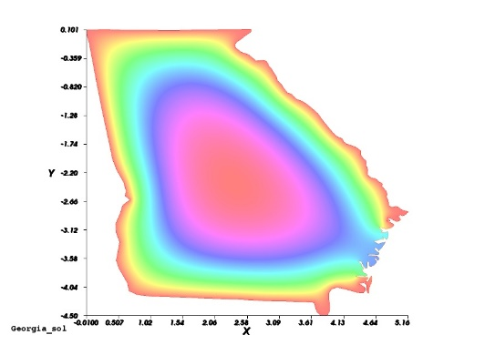
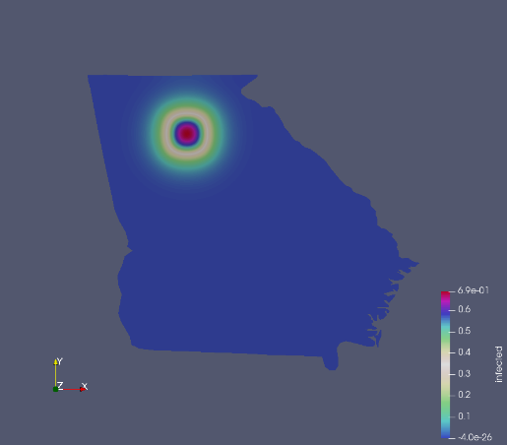
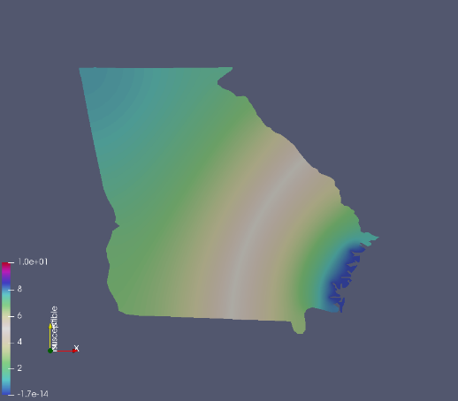
PDEs in Action
REM: To have MATH352 in background would help a lot with FreeFem++ (*edp files)
Courtesy of Alex Viguerie, former Emory student and postdoc in Pavia Italy
Specific research lines:
Define diffusion coefficients based on the geography (see KellerEtAl on CANVAS)
Work on USA (I will help)
Split the problem by counties (e.g. Georgia with A. Viguerie)
#EMORYdontGiveUp!

Slide 10
How and When
Team Name: Choose a fancy name for your team ☺
We will create the groups on Canvas
Report: 20 page
Executive Summary (max 1pag)
Look at SIAM Guidelines on CANVAS on Math Modeling and the Report
Objectives, Assumptions, Core, Stress test, Discussion, Conclusions
Bibliography (doesn’t count in the 20pag)
Delivery: Apr 30th 11.59pm on CANVAS
Mentoring: A. Veneziani will run specific Office Hours on Tuesday at 4 pm on Zoom
Ph.D. in Math and in Epidemiology may help if you need (A. Veneziani will bridge Undergrad and Grad)
To have clarifications on the talks you can ask L. Shu, M. Taskovic
Evaluation: An interdisciplinary committee will run the evaluations (mathematicians, statisticians, entrepreneurs)
Awards: The best three projects will receive an award (1000$, 500$, 250$)
#EMORYdontGiveUp!

Slide 11
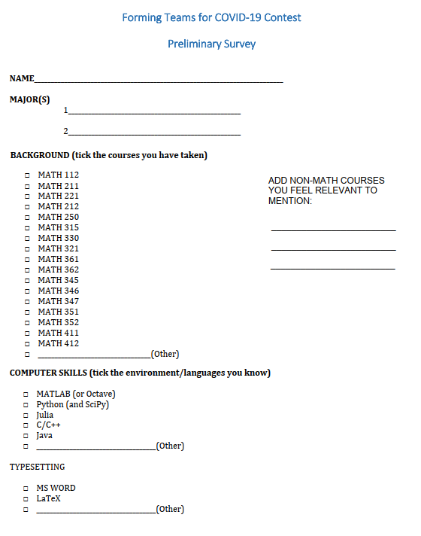
If you want to participate as a team, but you do not have one, let us know.
We will try to assemble teams.
Please, to help us, fill the survey on Canvas (------------ >)
and send to avenez2@emory.edy
by 4/3 at 11.59 pm

Slide 12
SOME FINAL REMARKS/GUIDELINES
The spirit of this initiative is INCLUSIVE (not exclusive):
We are a community, we are a team, we have a common enemy (COVID-19) and we are all together in this
We are Emory, we will never give up until we win, and we will win together
So, if you have your idea of modeling in mind, feel free to follow it
If you feel you do not have enough experience/background, but you want to learn, find your role and make your part: we need you anyway, we will find a team for you
The Emory code is your rule: reaching out for help is fine, with your professors too, but just disclose it in your report.
The awards are like salt or pepper on your food: to make it more tasty and spicy, but the truth is that this experience wants to reinforce your sense of belonging to our community, this is a great “collaborative” effort more than a competition.
#EMORYdontGiveUp!

Slide 13
#EMORYdontGiveUp!
Q&A?
avenez2@emory.edu
#EMORYdontGiveUp!

